Slide 1
Price Prediction for Mobile Phones

Slide 2
Introduction
The Project Name- Price Prediction for Mobile Phones
I use Python code to upload the data from the mobile.csv file
# LOAD DATA
data=pd.read_csv('mobile data.csv')

Slide 3

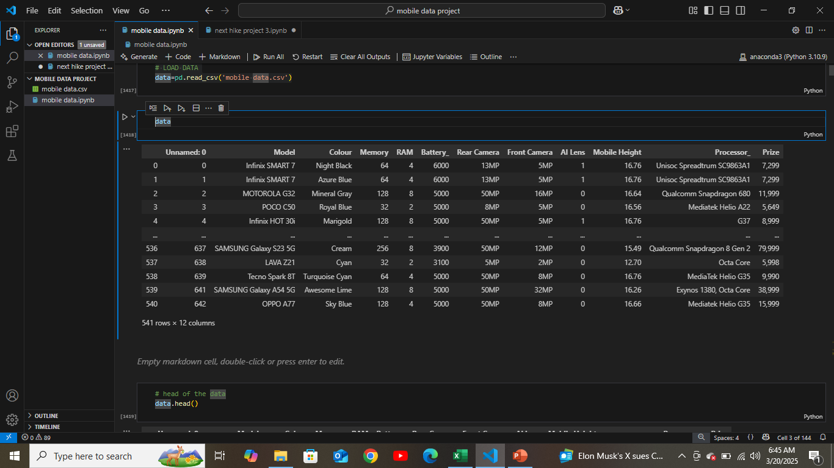

Slide 4

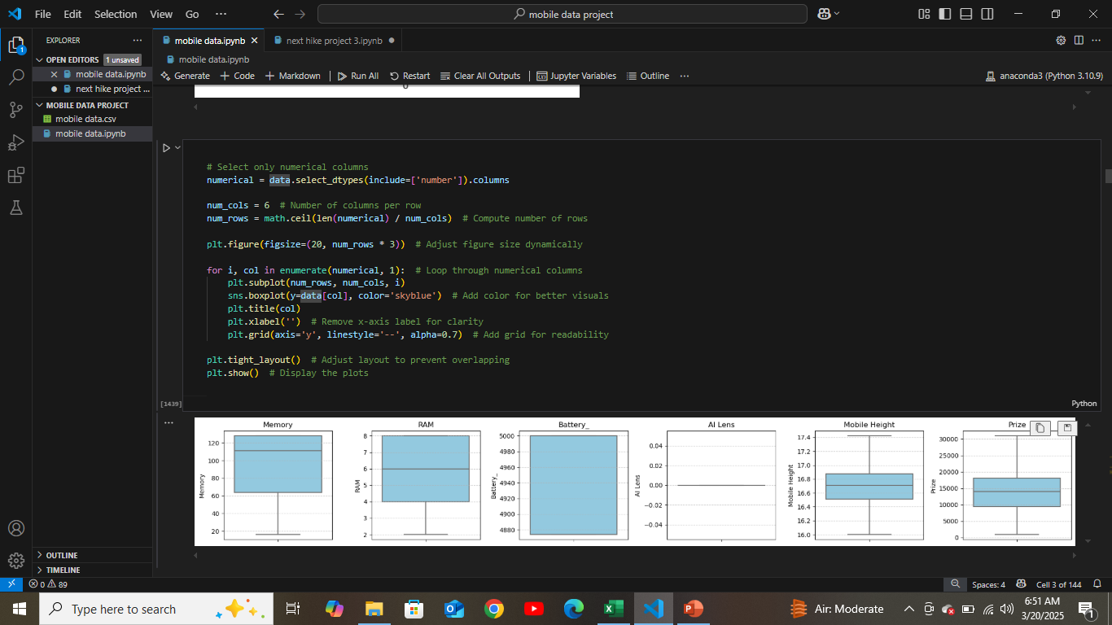
Remove out liear box plot

Slide 5
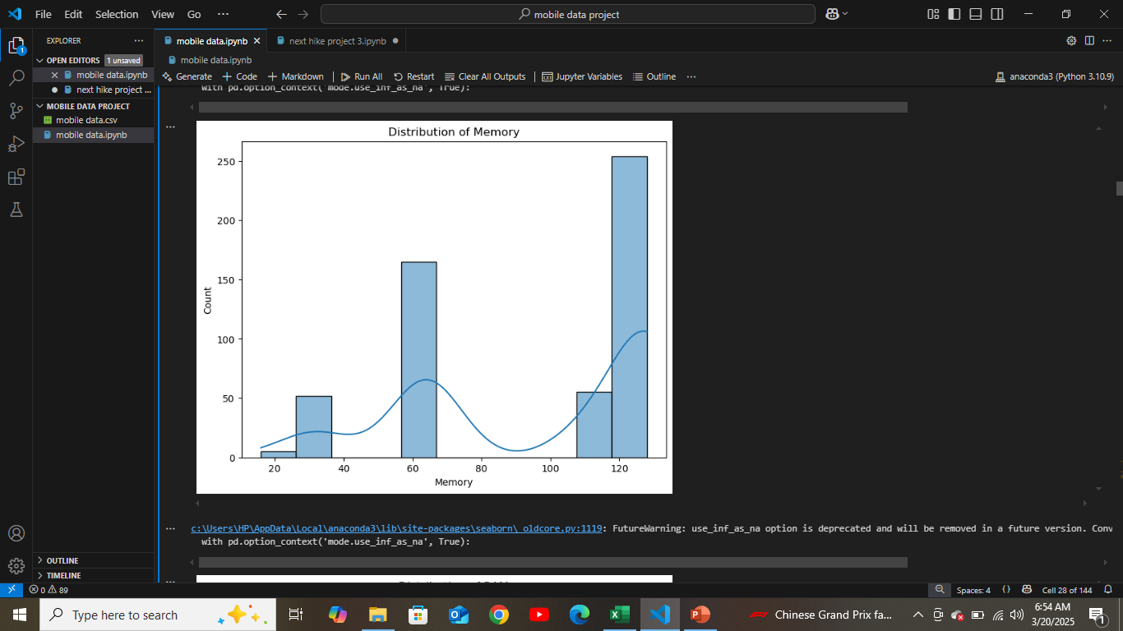
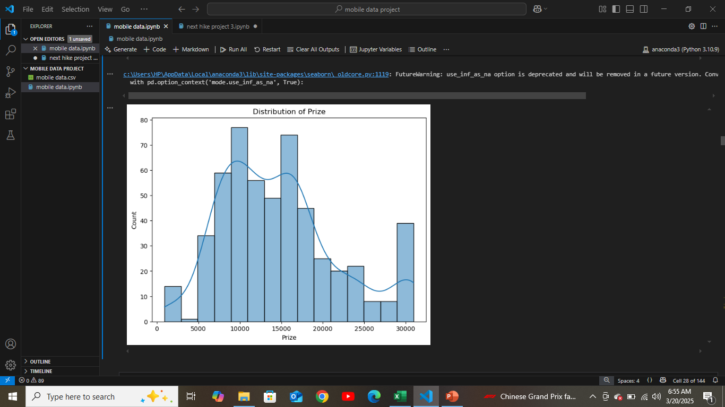
DISTRIBUTION pRIZE

Slide 6
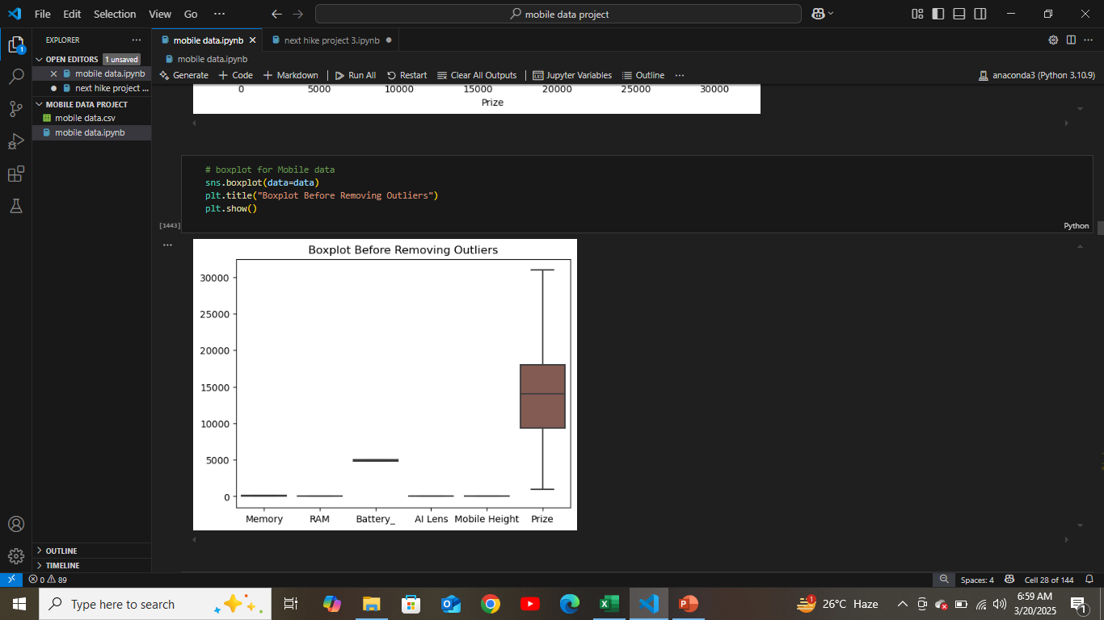
Boxplot Before Removing Outliers

Slide 7
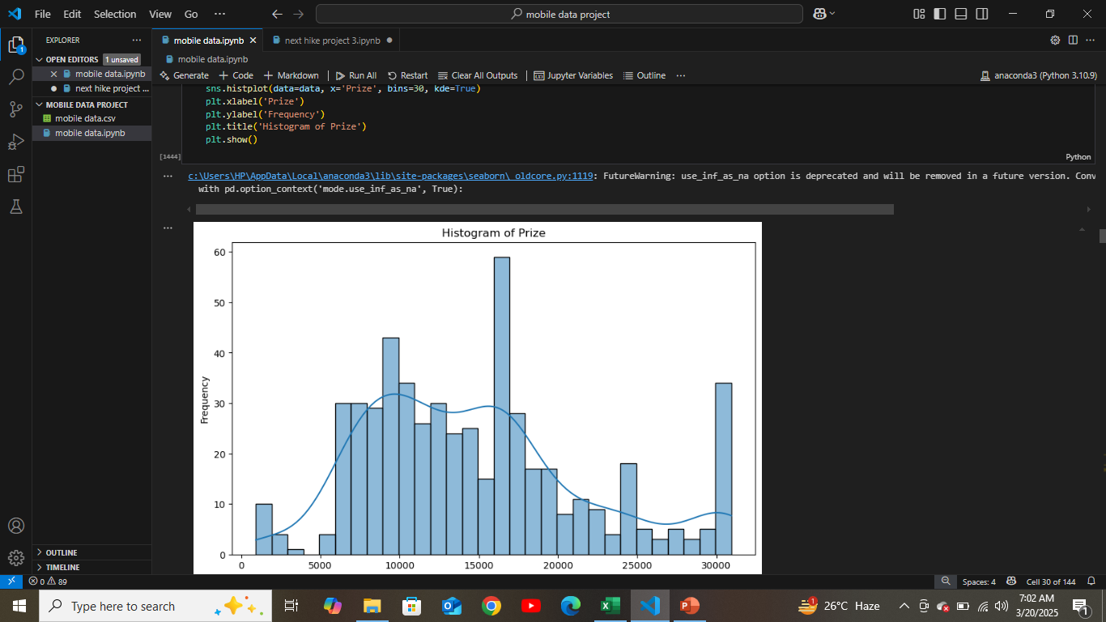
Histogram of prize

Slide 8
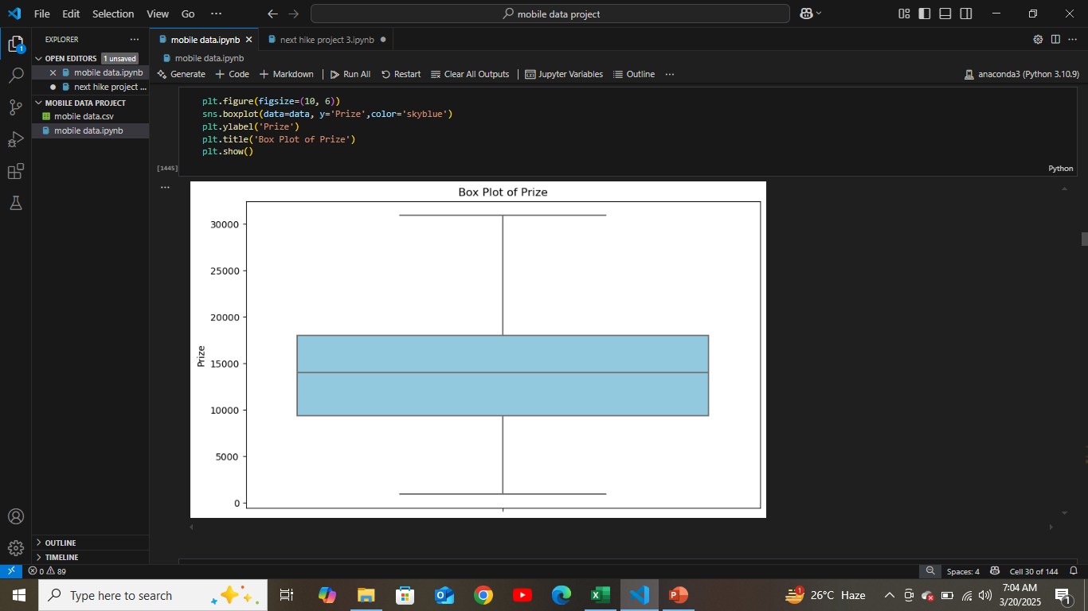
Box plot of Prize

Slide 9
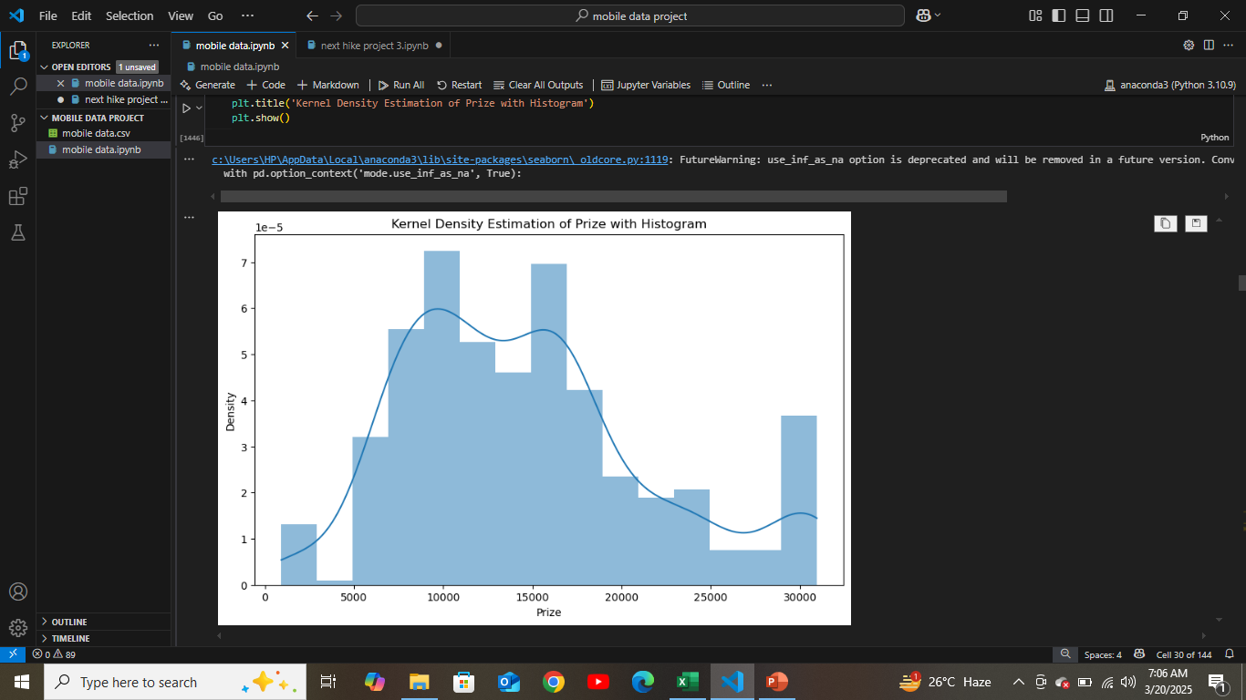
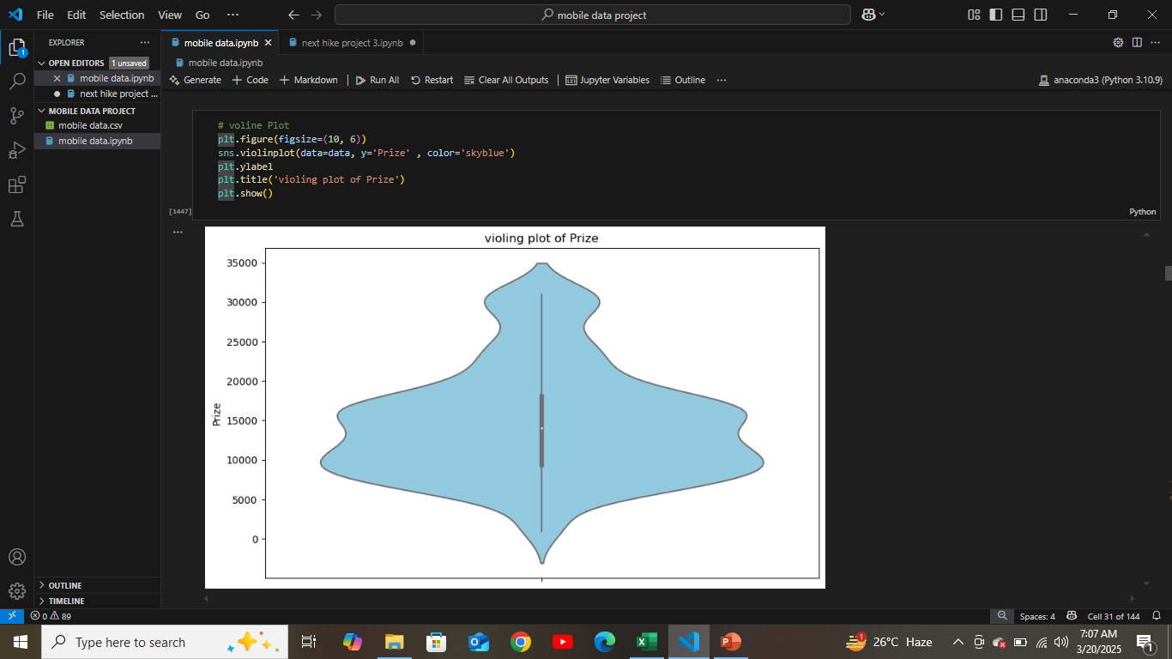

Slide 10

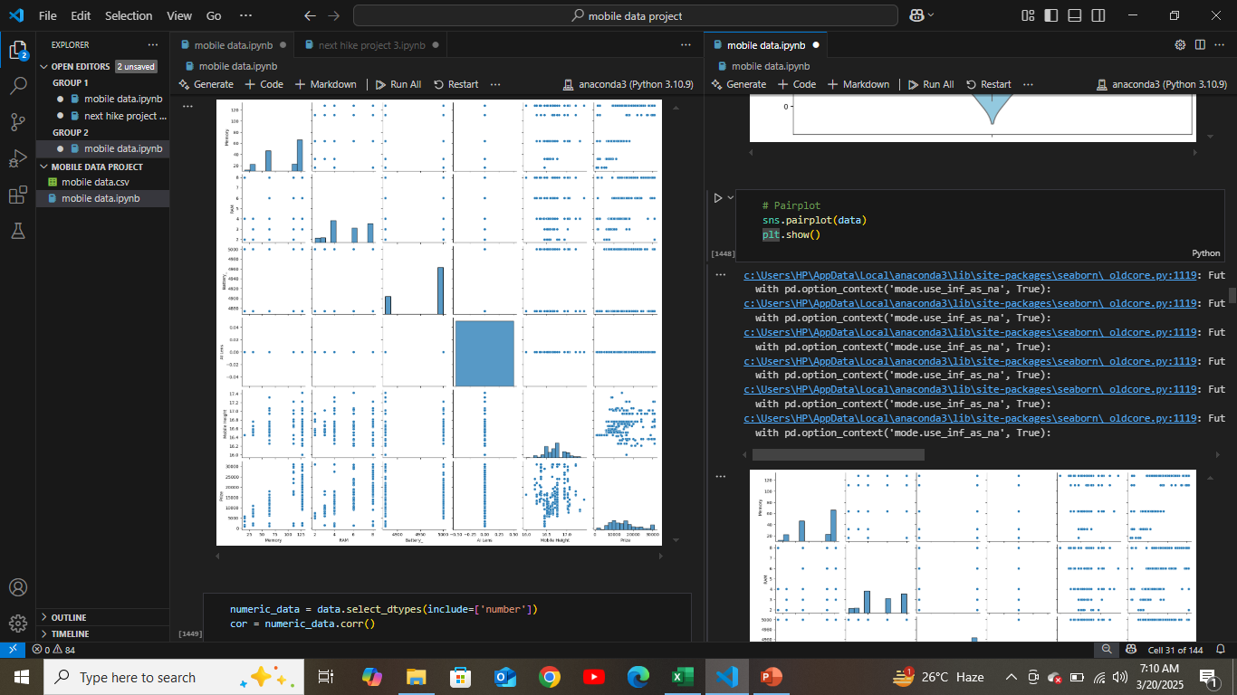
Pair plot

Slide 11
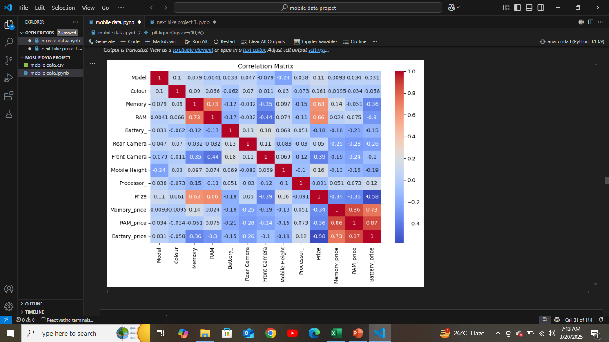

Heat map correlation Metrix

Slide 12
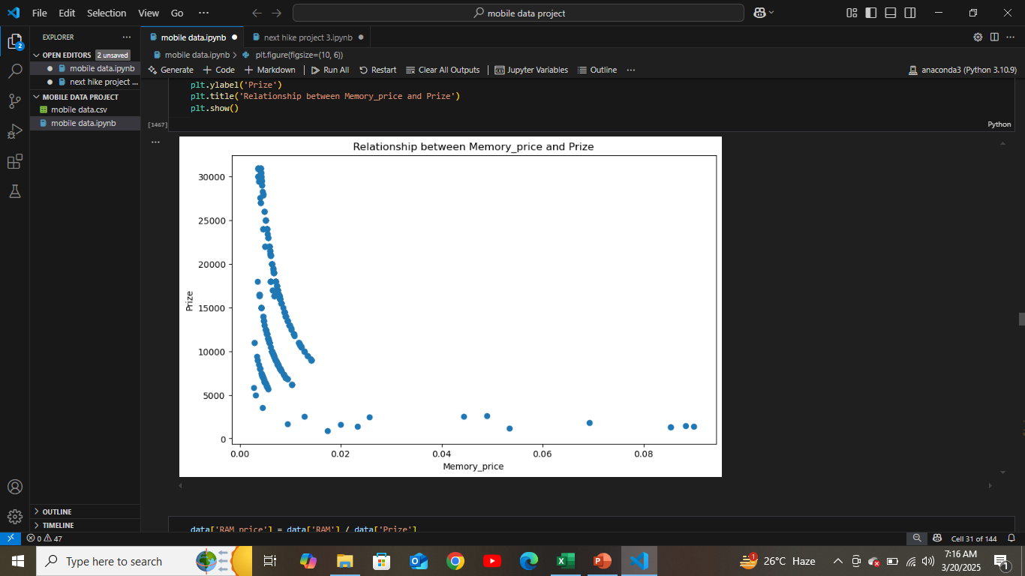
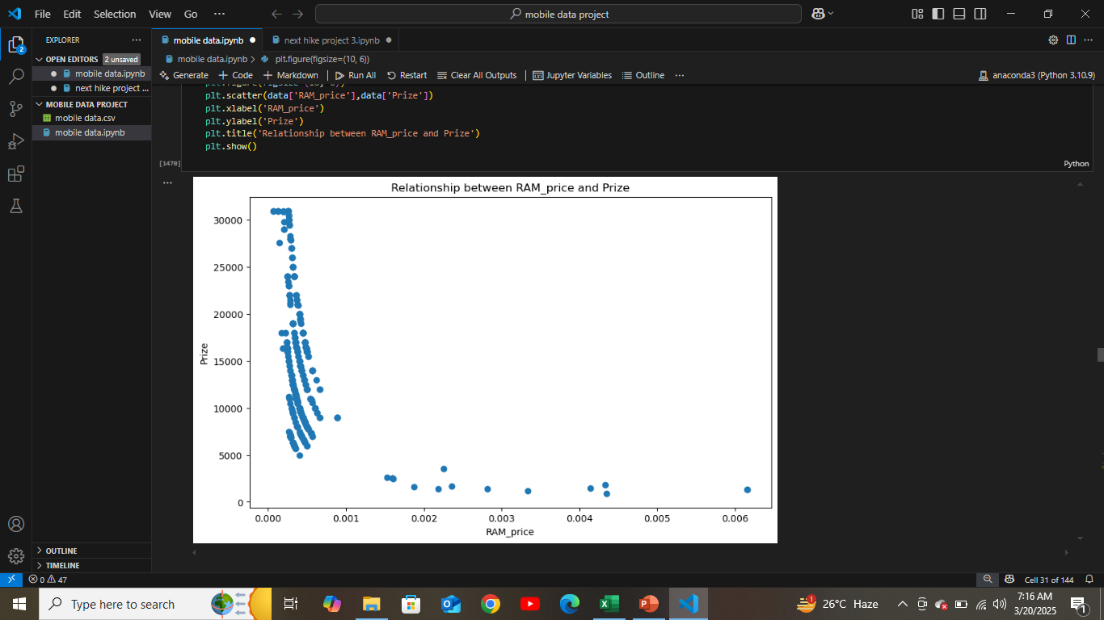
Relation between memory and Ram with Prize

Slide 13
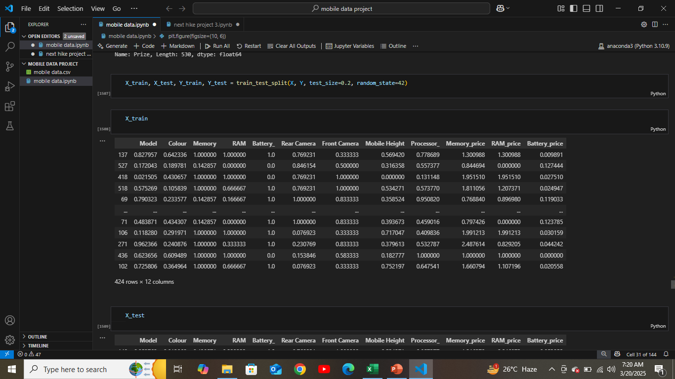
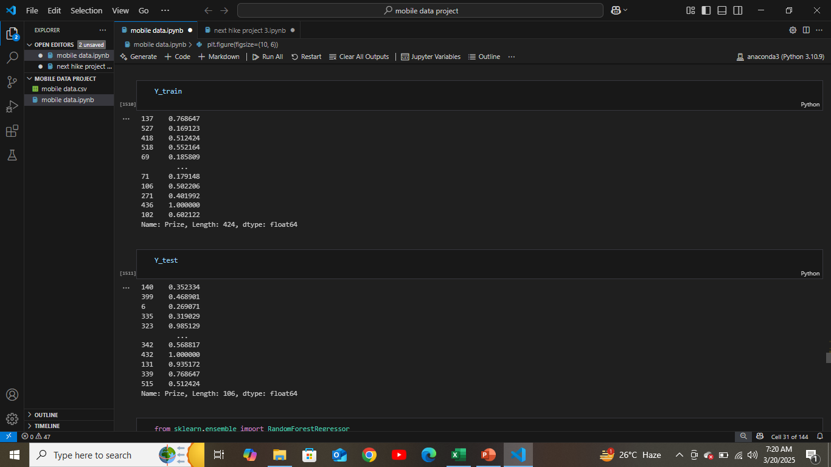
X-train and y train ,y test

Slide 14
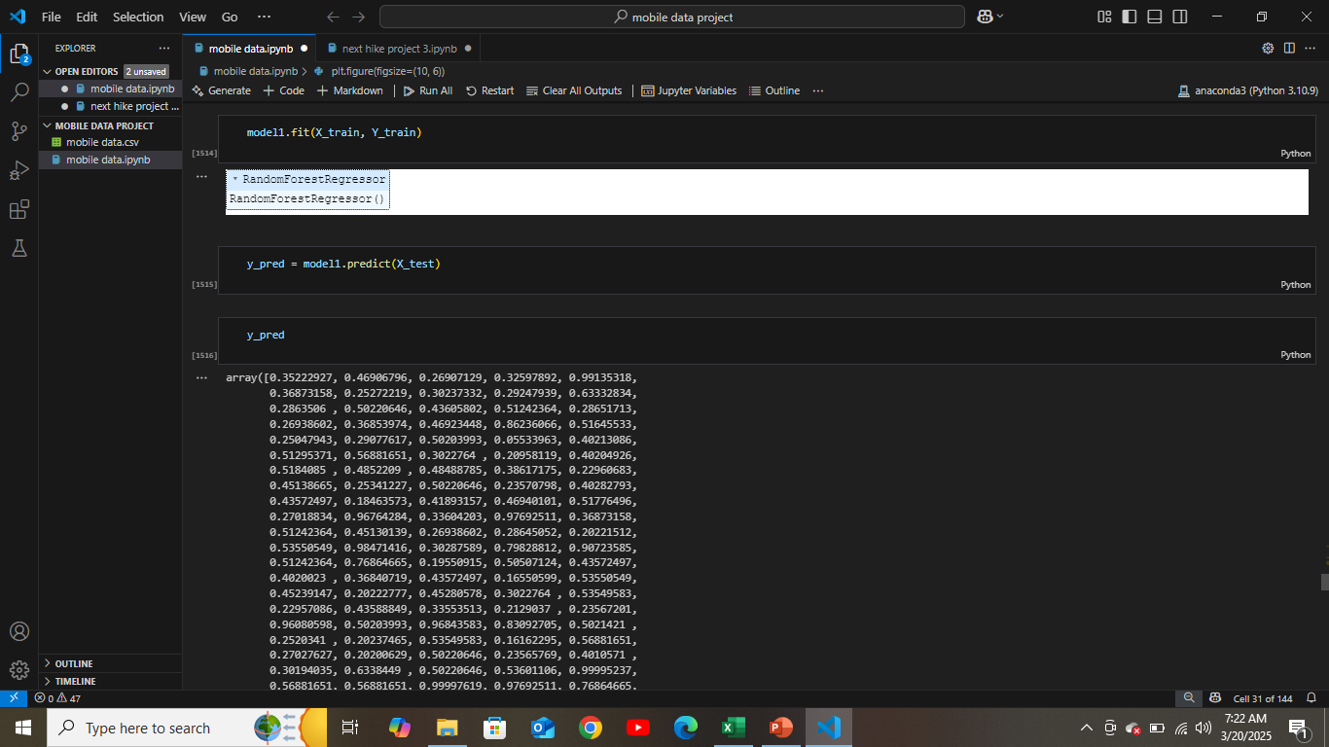
model1 = RandomForestRegressor()

Slide 15
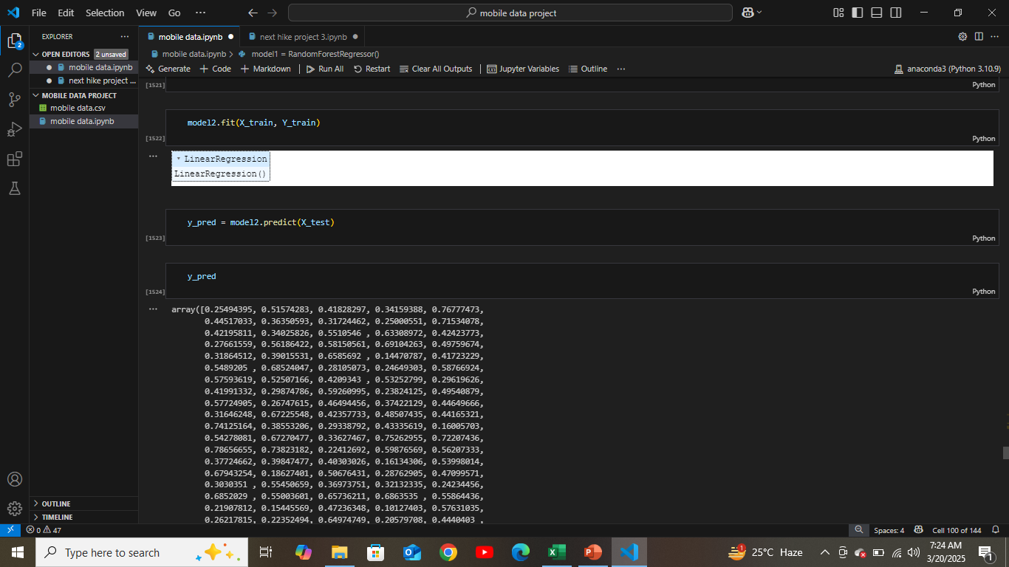
model2 = LinearRegression()

Slide 16
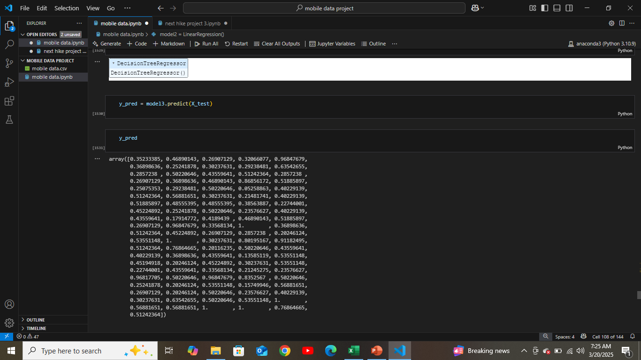
model3 = DecisionTreeRegressor()

Slide 17
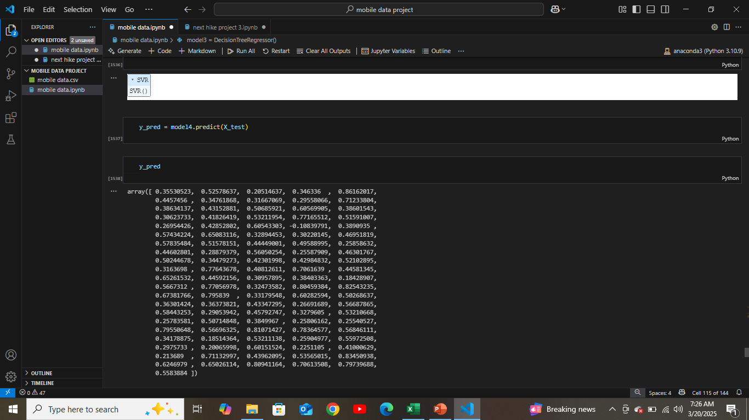
model4 = SVR()

Slide 18
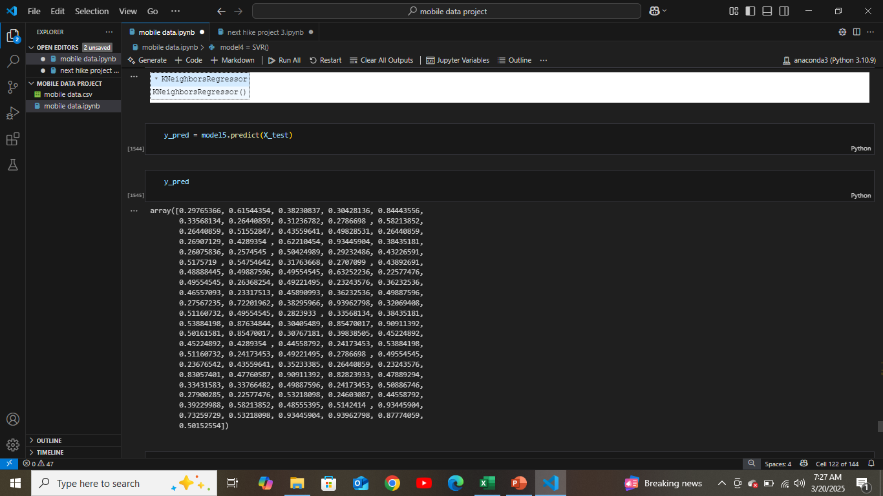
model5 = KNeighborsRegressor()

Slide 19
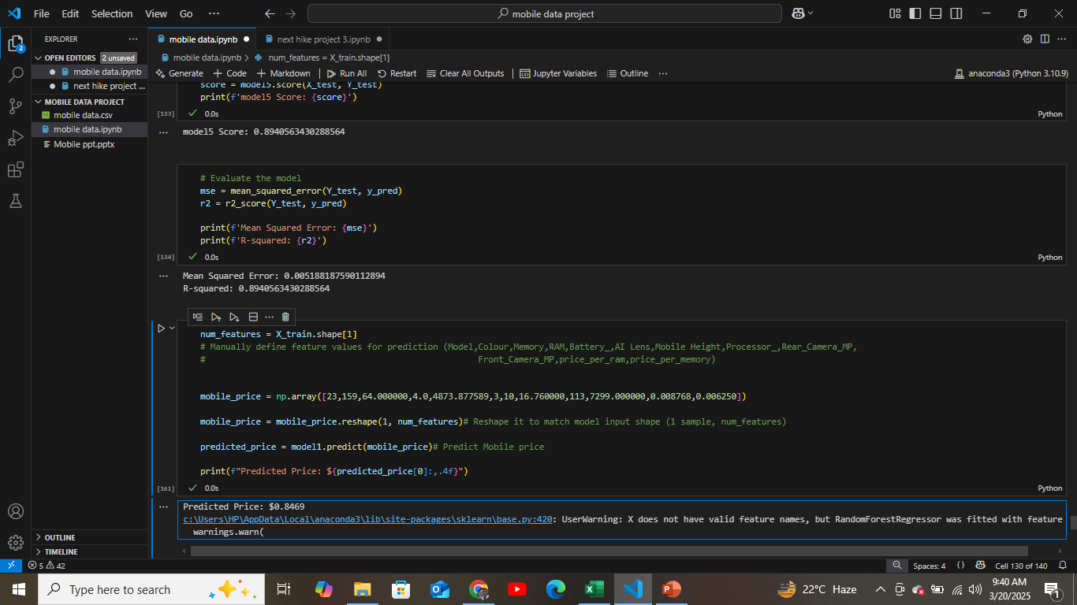
Predicted Price: $0.8469

Slide 20
Thank you
ABHINAV TIWARI

